Slide 1
Version control with Github Desktop
Shuai Wei
IS&T Boston University

Slide 2
Git

Slide 3
github.com

Slide 4
GitHub desktop

Slide 5
Setting up GitHub Desktop
Installing GitHub Desktop
https://desktop.github.com/
Authenticating to GitHub
Add your GitHub.com account information to GitHub Desktop
Configuring Git for GitHub Desktop
If you don’t have Git installed, you must configure it before using GitHub Desktop.

Slide 6
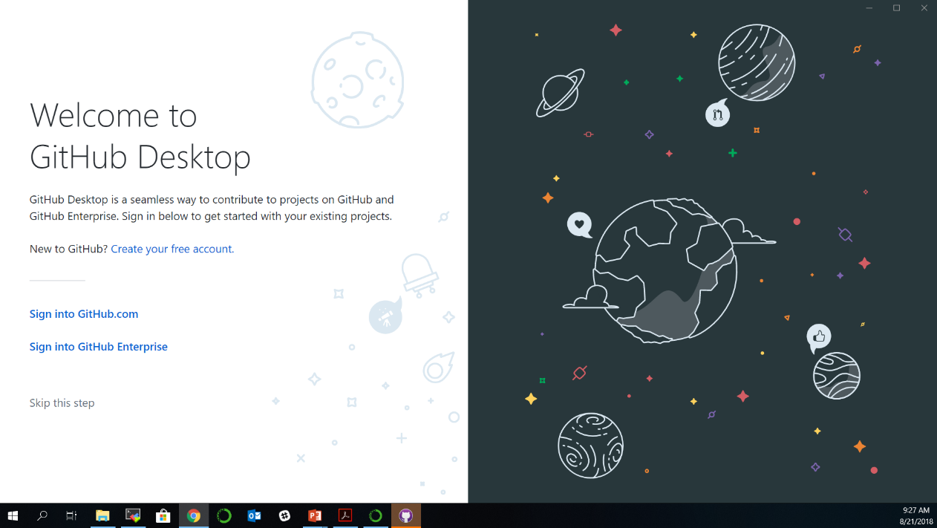
Authenticating to GitHub
or

Slide 7
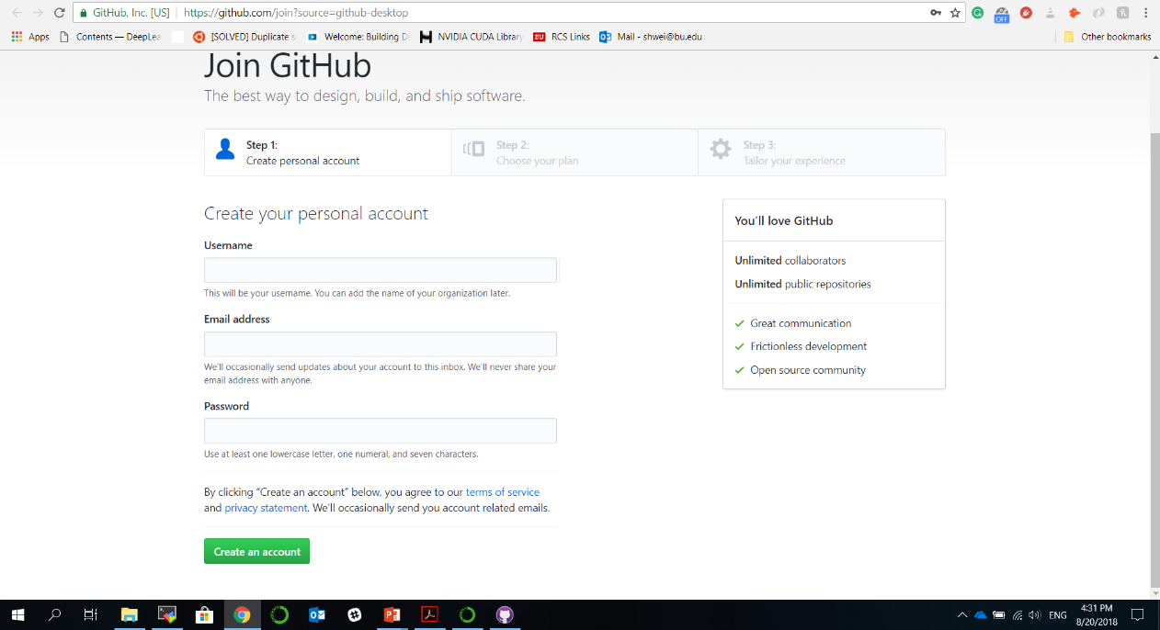
Creating GitHub account if you don’t have an account already

Slide 8
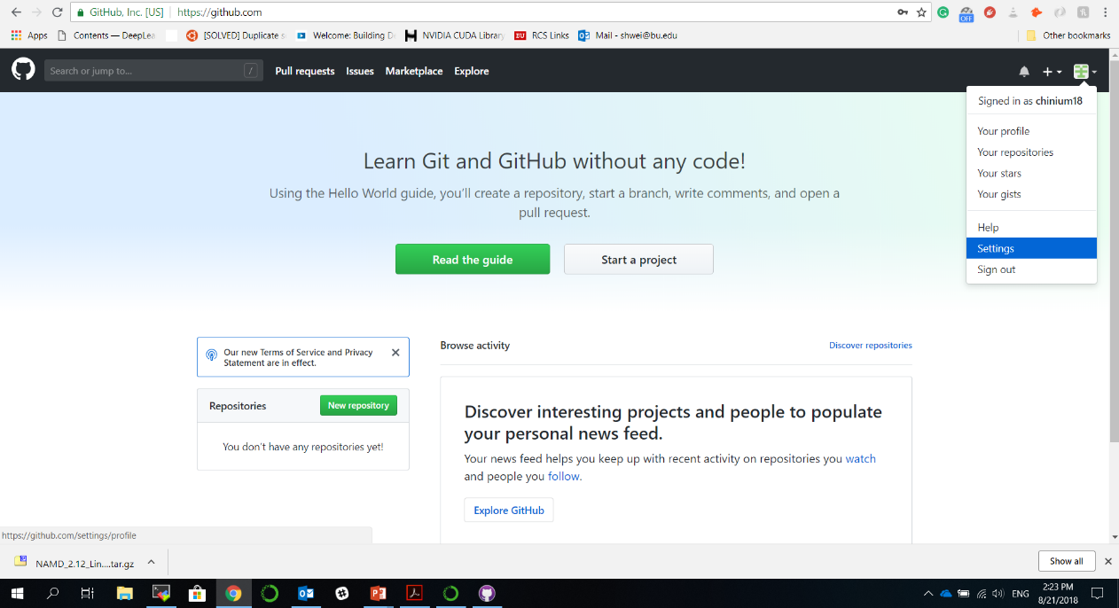
Configuring GitHub account

Slide 9
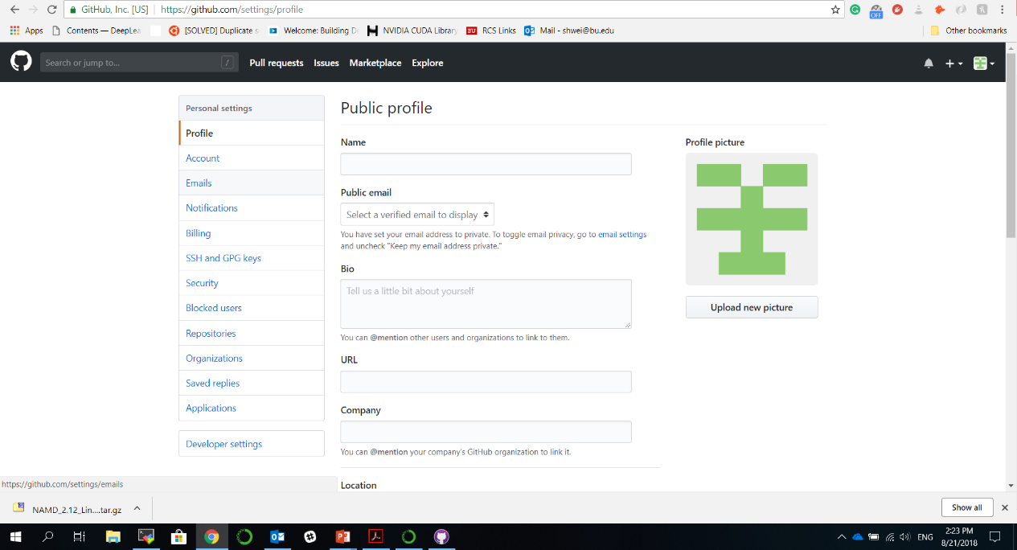
Configuring GitHub account

Slide 10
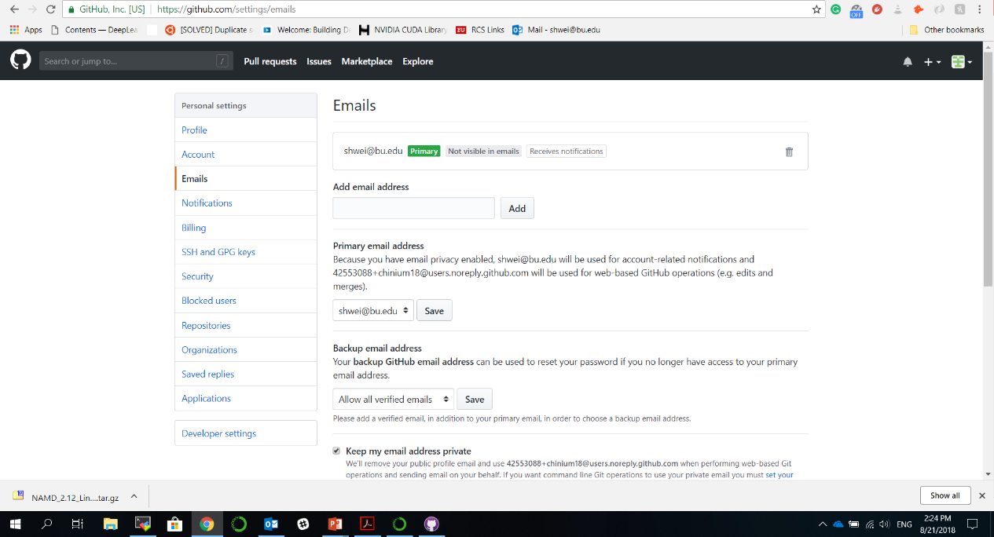
Configuring GitHub account

Slide 11
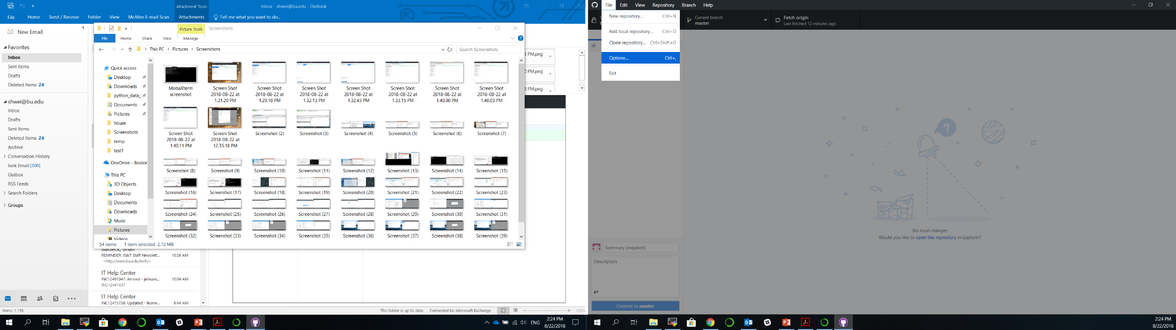
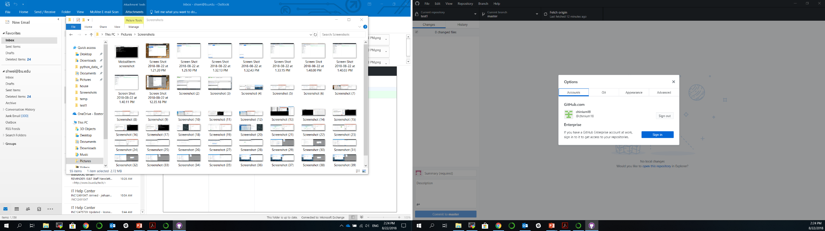
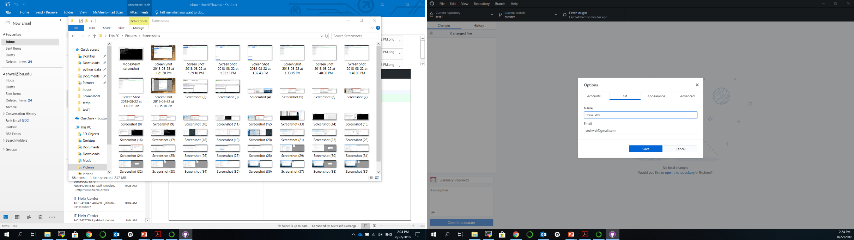
GitHub Desktop Setup

Slide 12
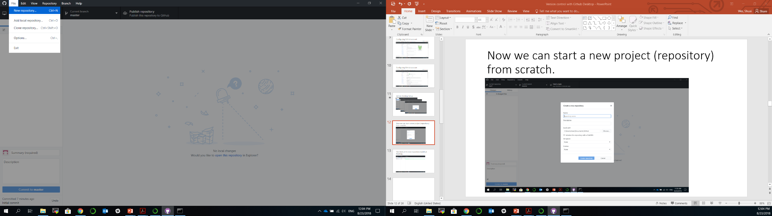
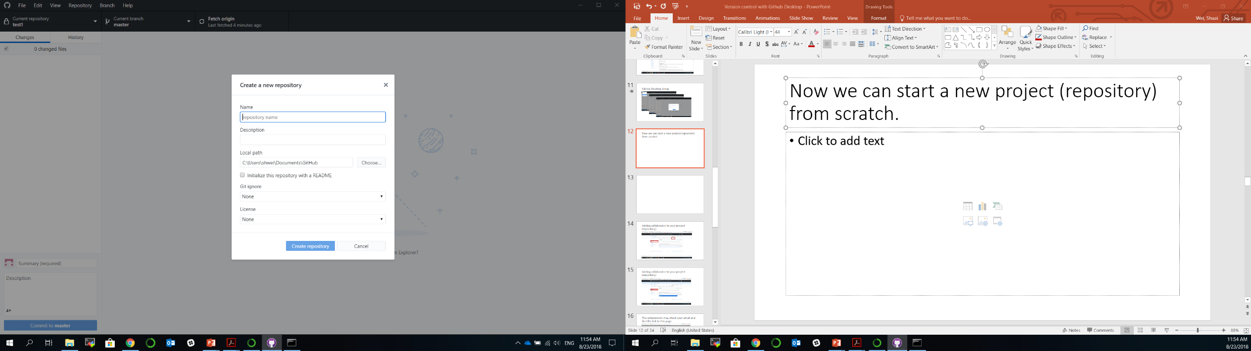
Now we can start a new project (repository) from scratch.

Slide 13
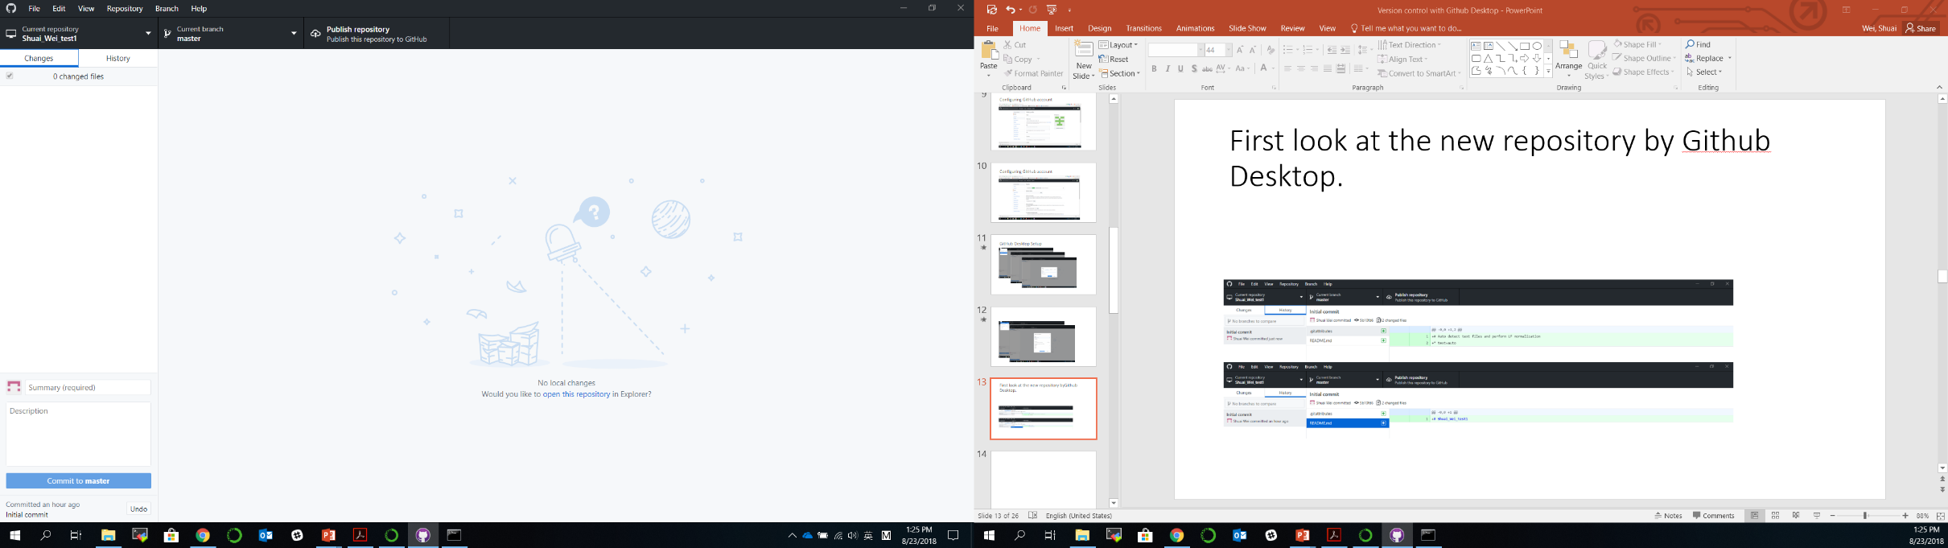
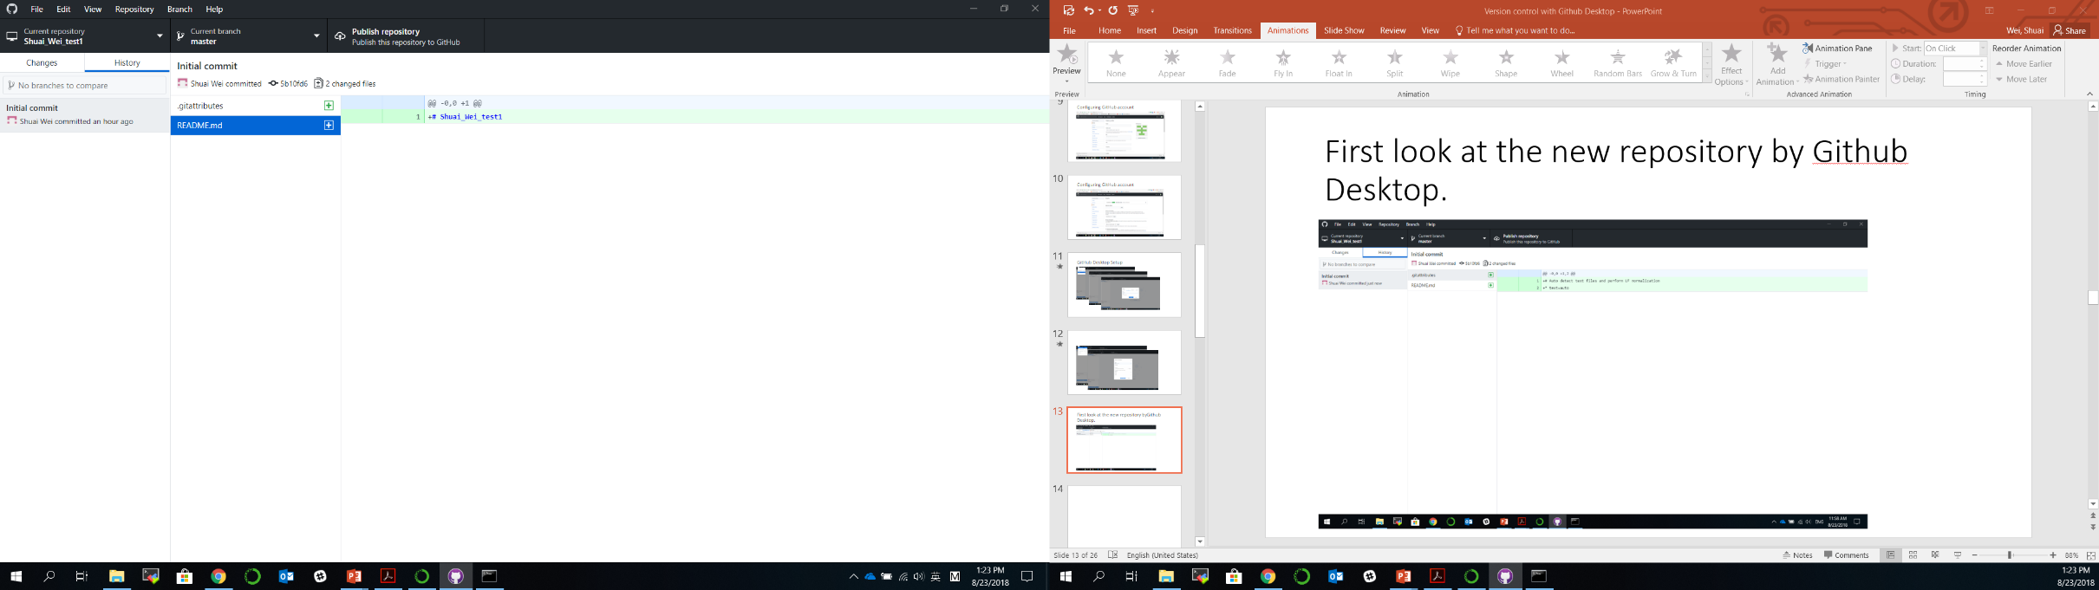
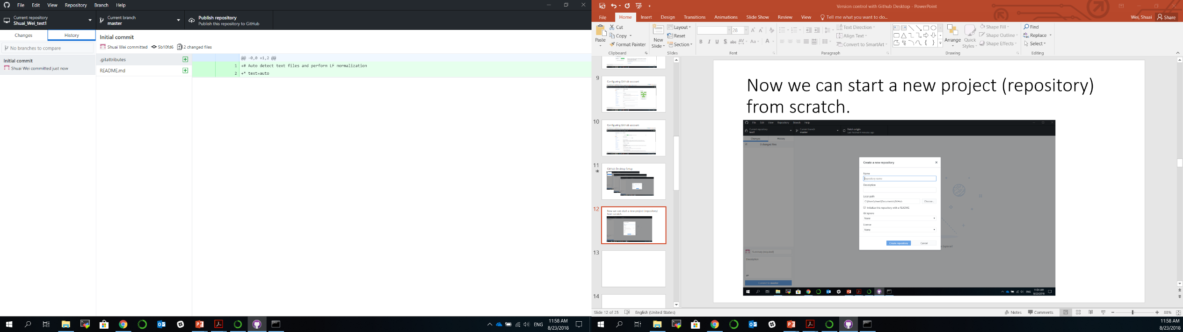
First look at the new repository by Github Desktop.

Slide 14
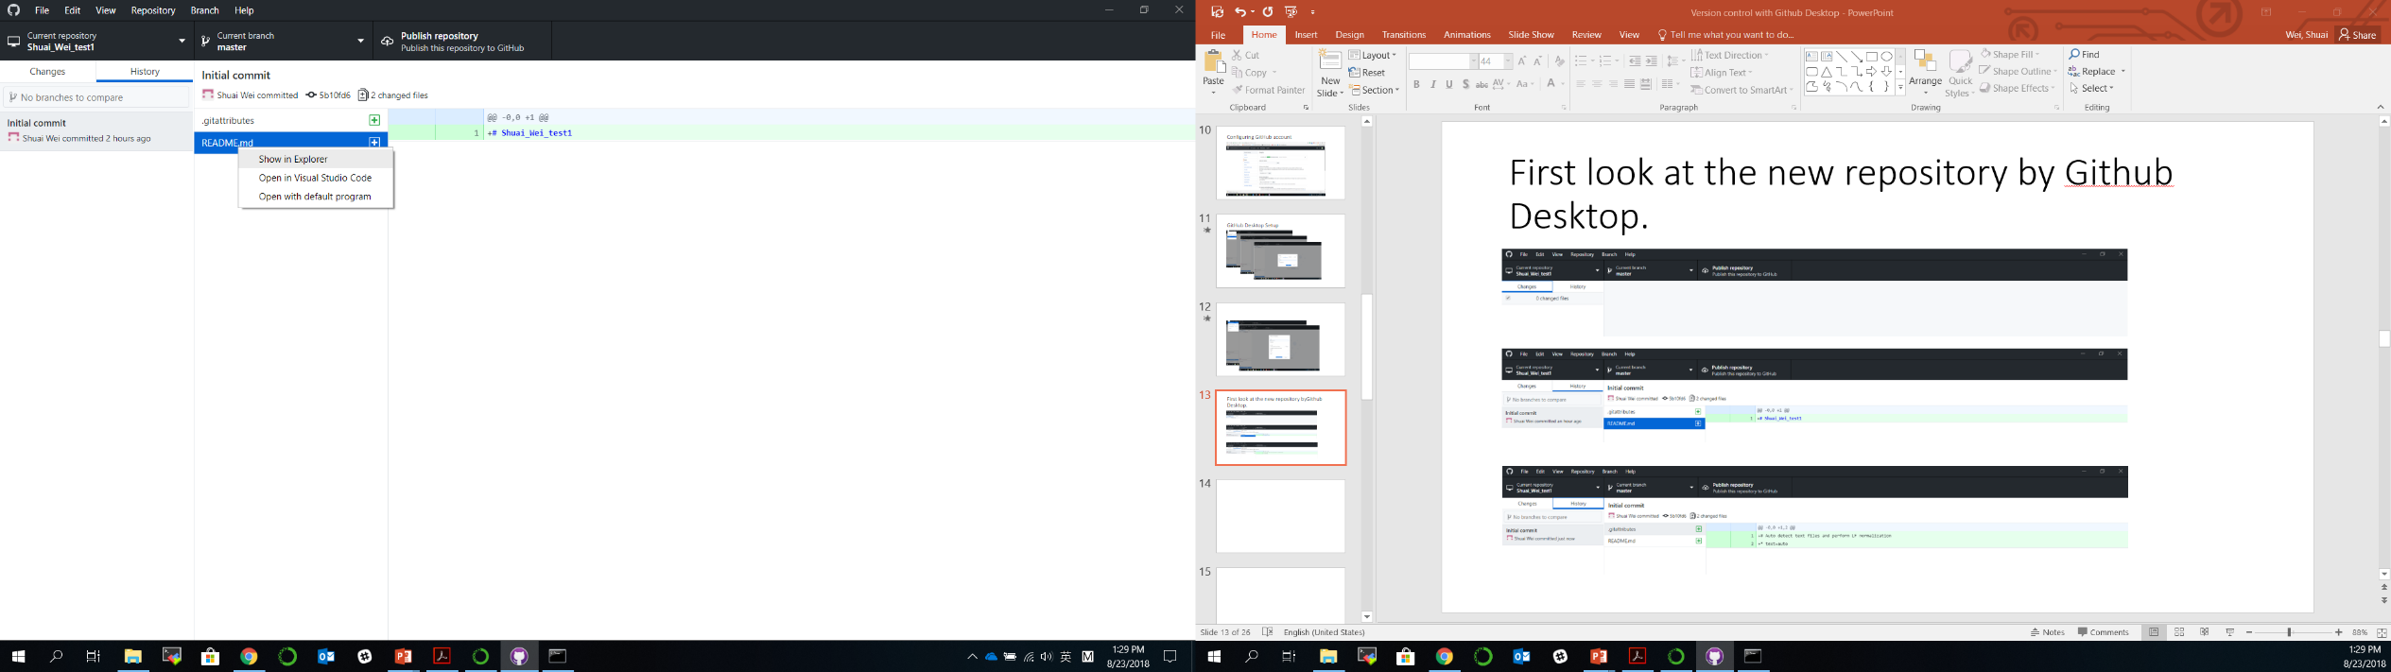
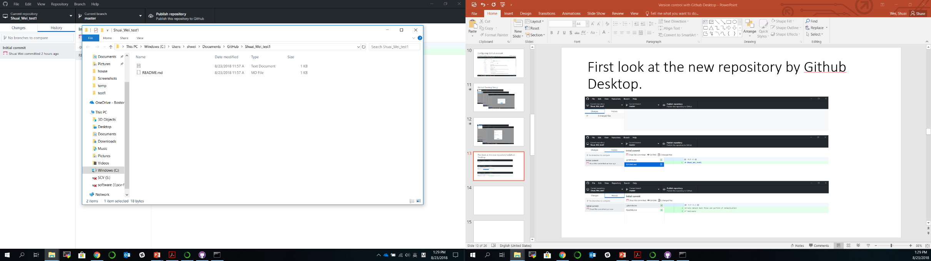
Show in folder and edit files/codes
Right click

Slide 15
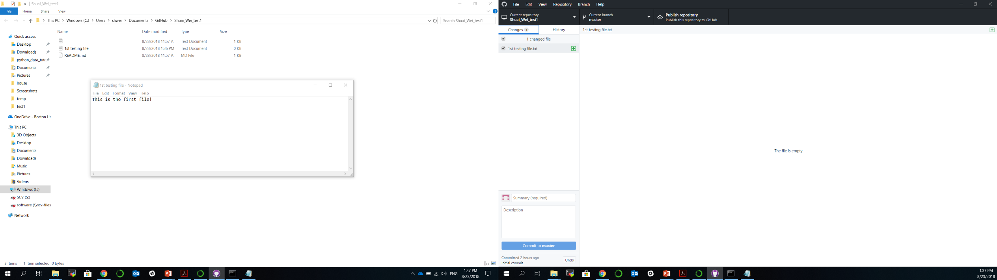
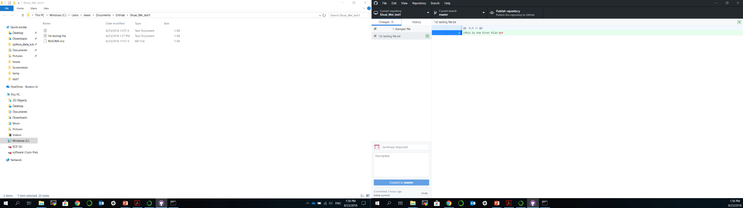

Slide 16
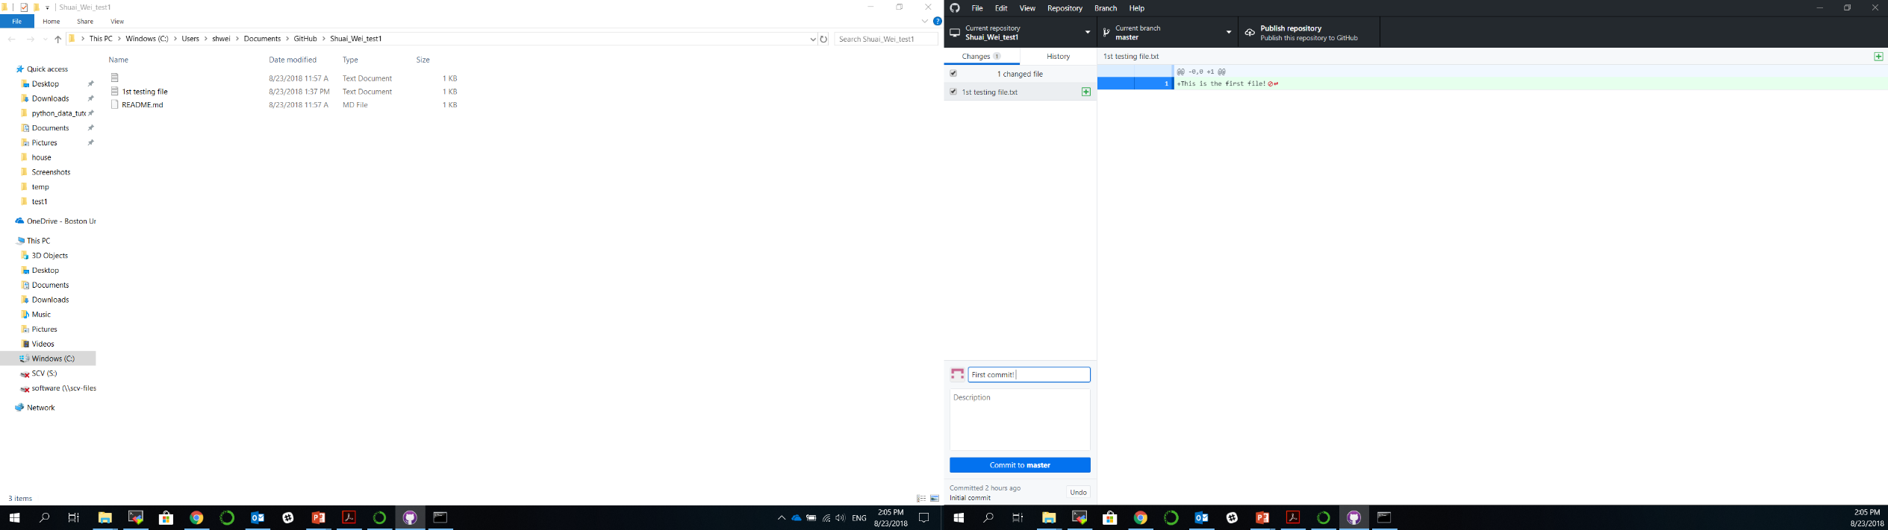
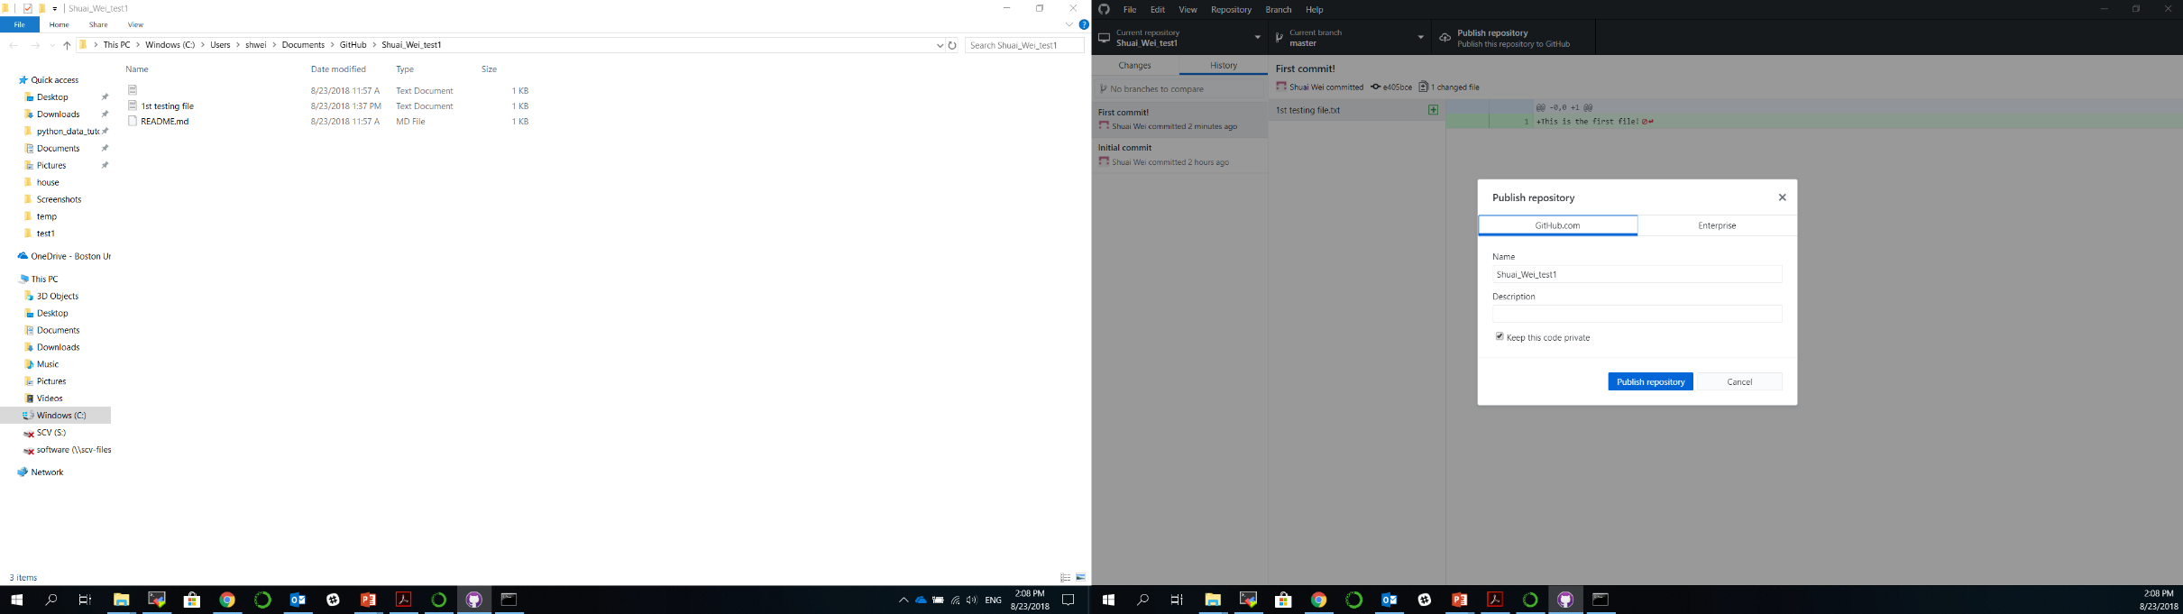
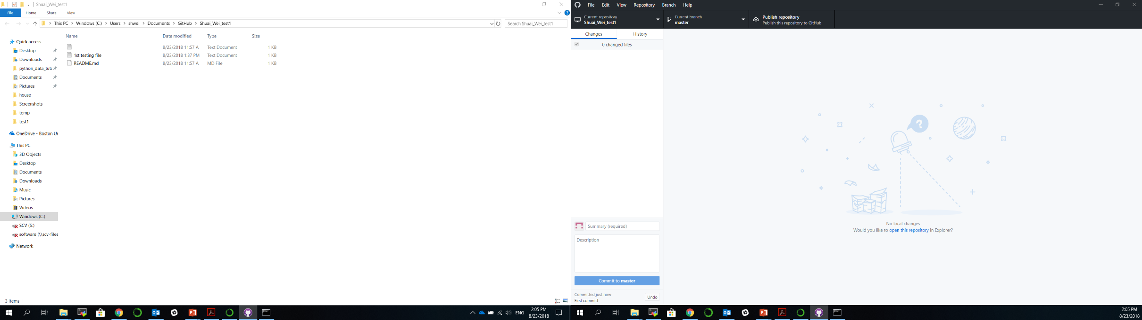
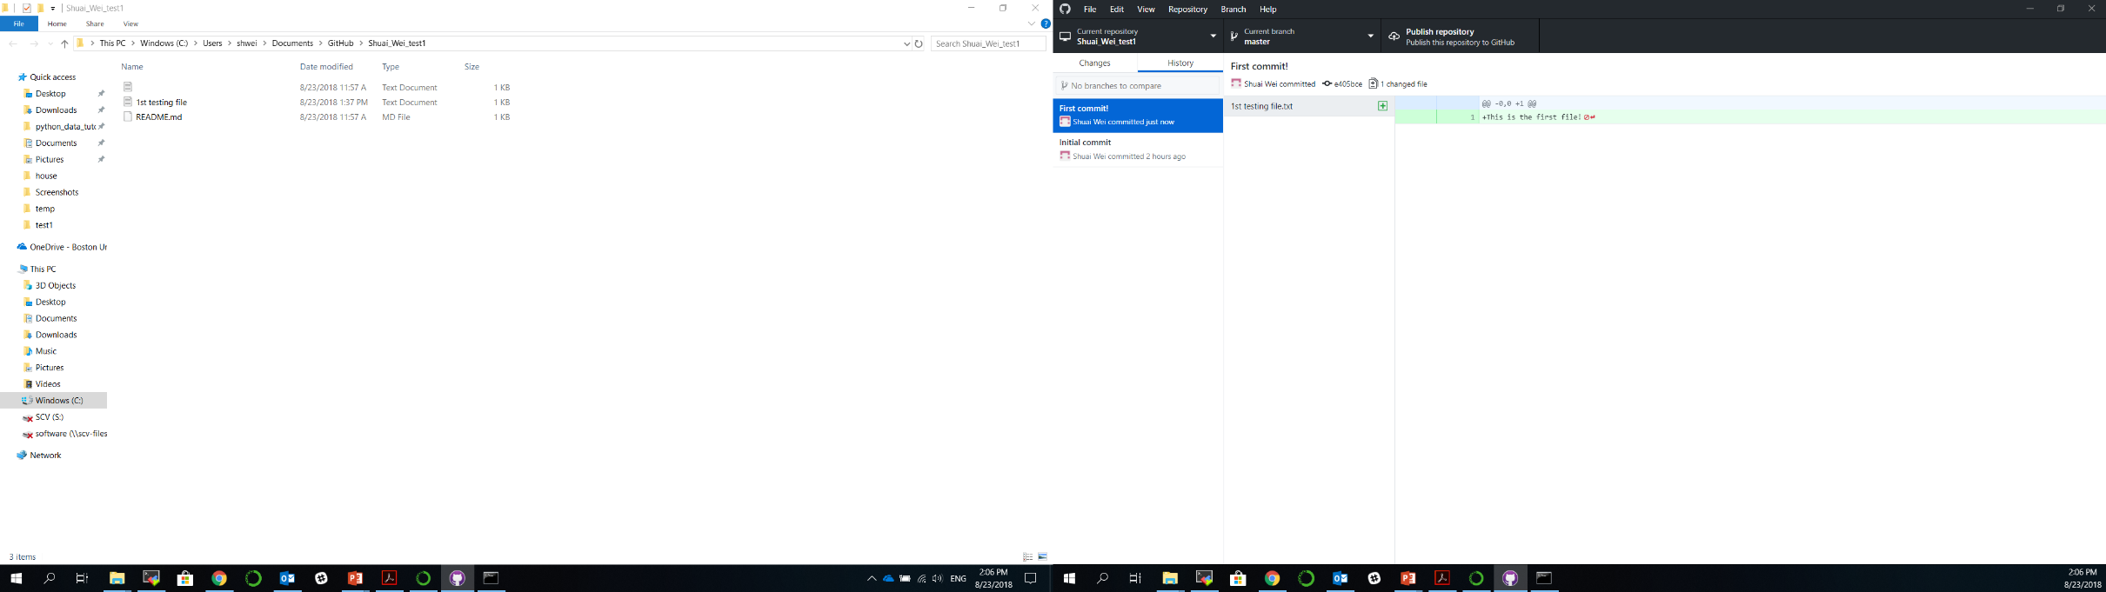
1st commit
1st push

Slide 17
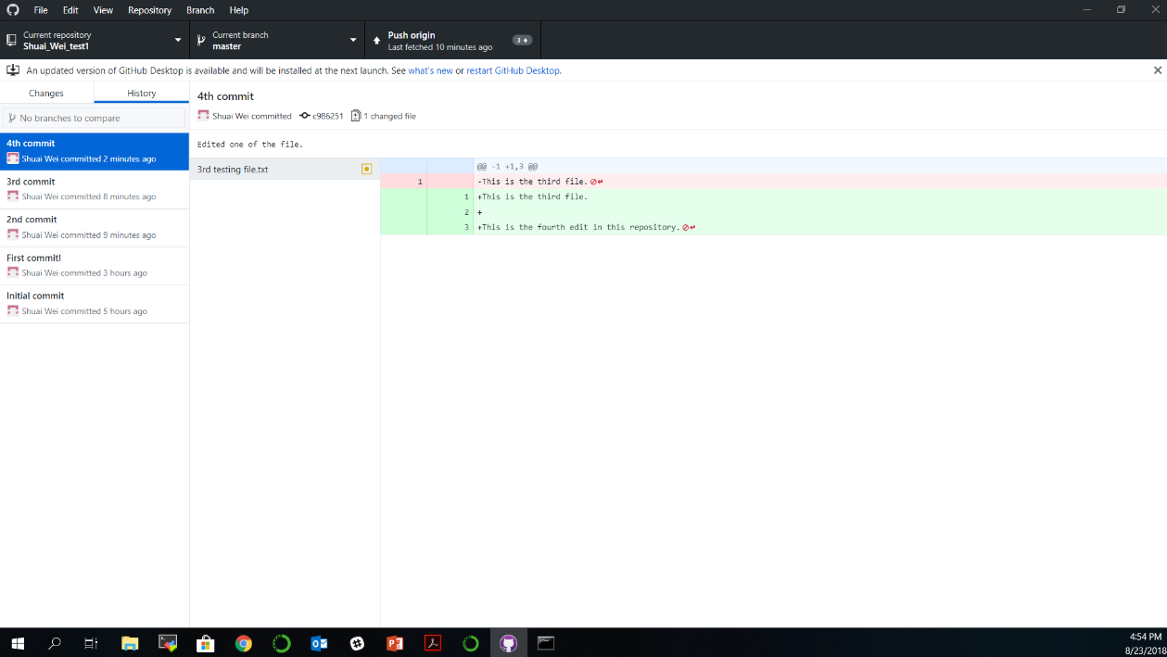
2nd, 3rd, 4th …

Slide 19
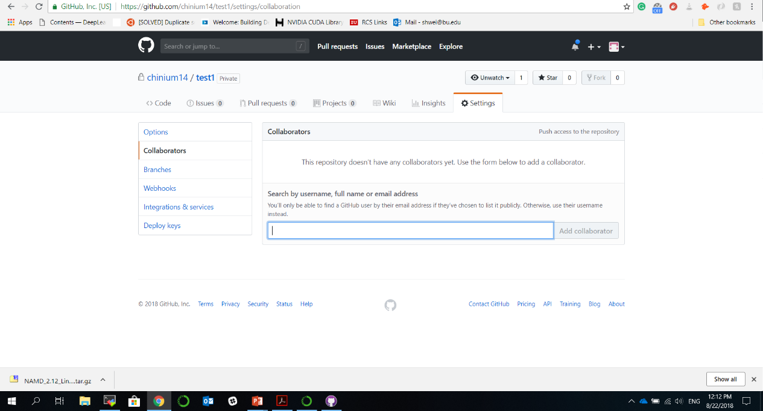
Adding collaborator to your project (repository)

Slide 20
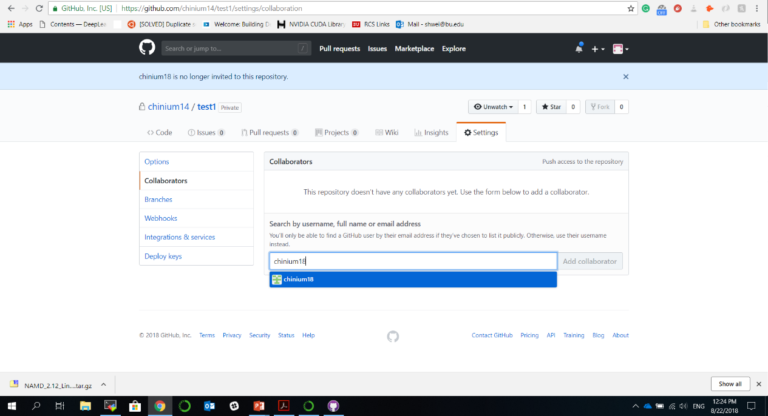
Adding collaborator to your project (repository)

Slide 21
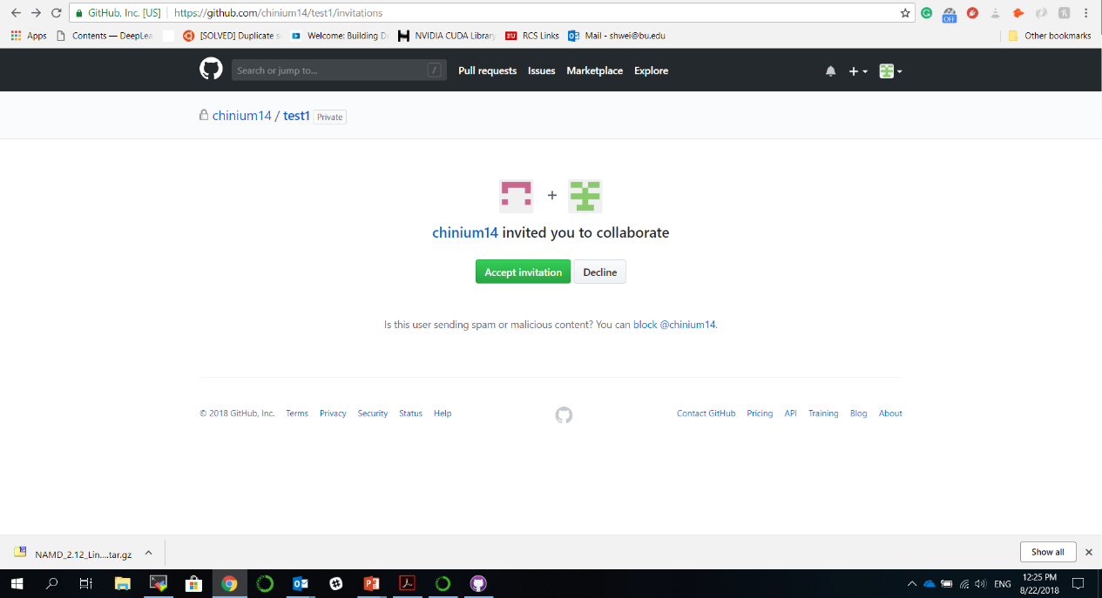
The collaborator: may check your email and find the link to this page.
Click on this button to accept the invitation.

Slide 22
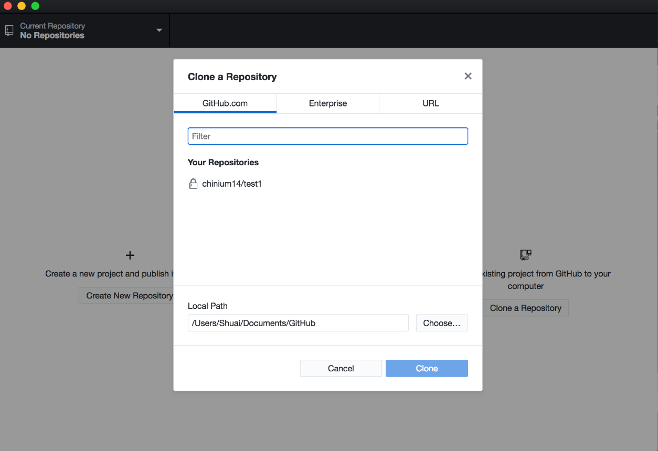
The collaborator: clone a repository from the organizer.

Slide 24
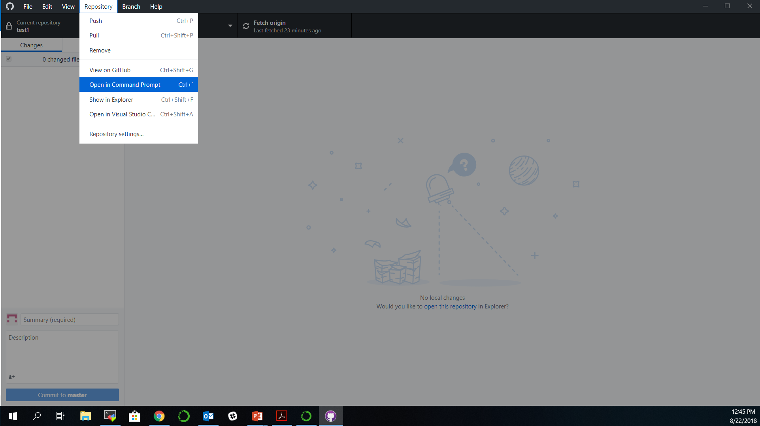
Extras for command line users

Slide 25
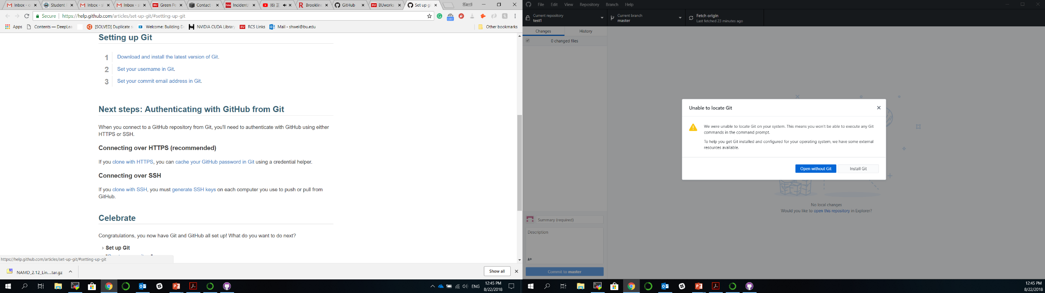
Install Git to use command lines

Slide 26
Instruction for Git setup
https://help.github.com/articles/set-up-git/#setting-up-git

Slide 27
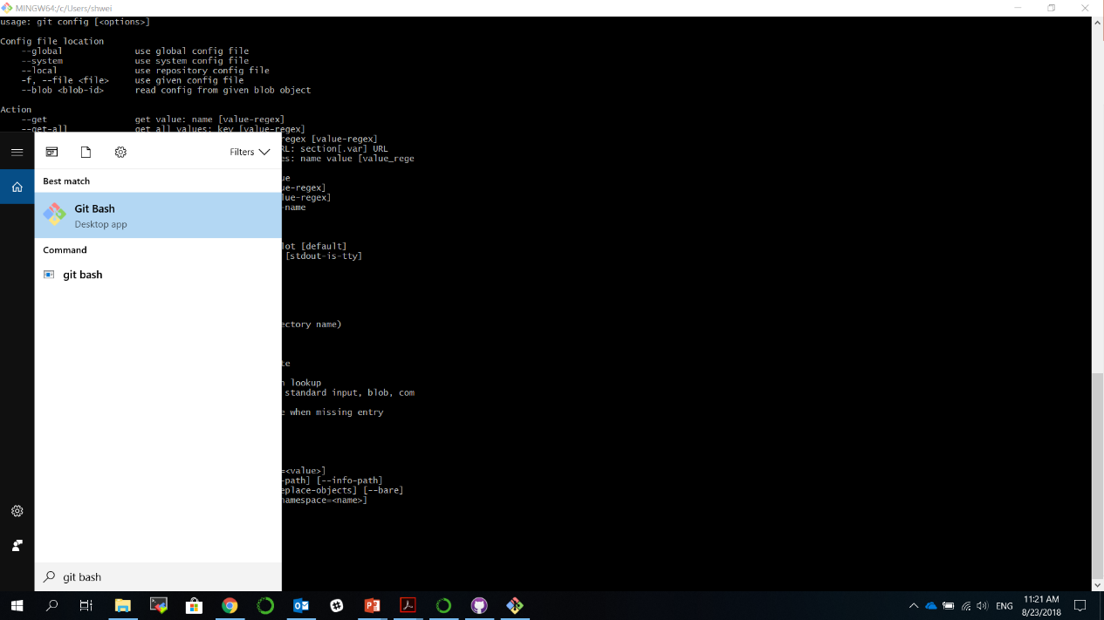
Set up Git

Slide 28
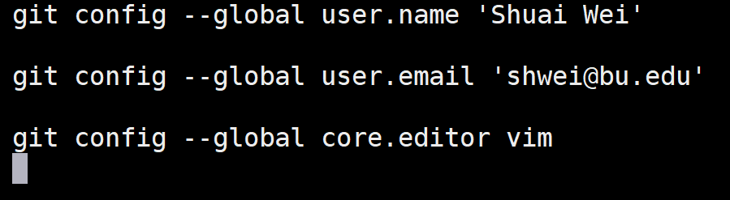
Git basic configuration
Command
Flag
Key
Value
Interpreter
program
Notes:
•Vim is the default editor used by git
•Select gedit if you are not familiar with vim or emacs editors

Slide 29
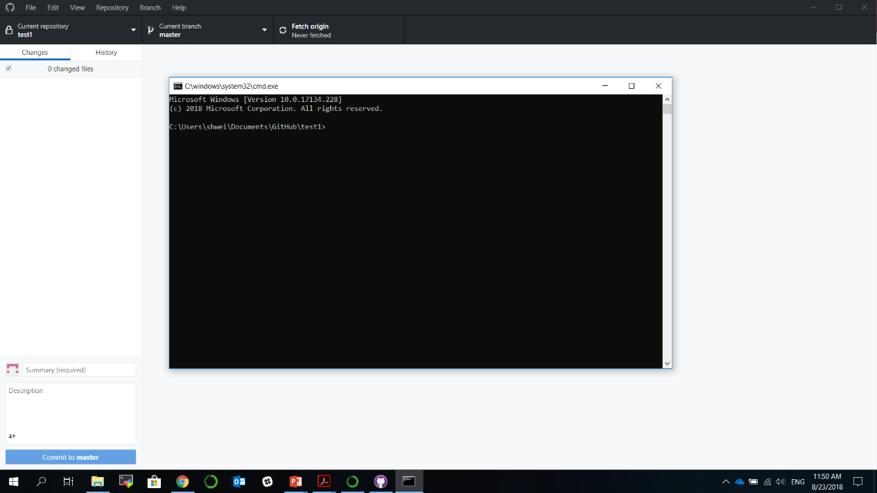
Now the command line will be available.

